Slide 1

Customer Shopping Behavior Analysis
Analysis of 3,900 transactions to reveal spending patterns, segments, product preferences, and subscription behavior to inform strategy.

Slide 2
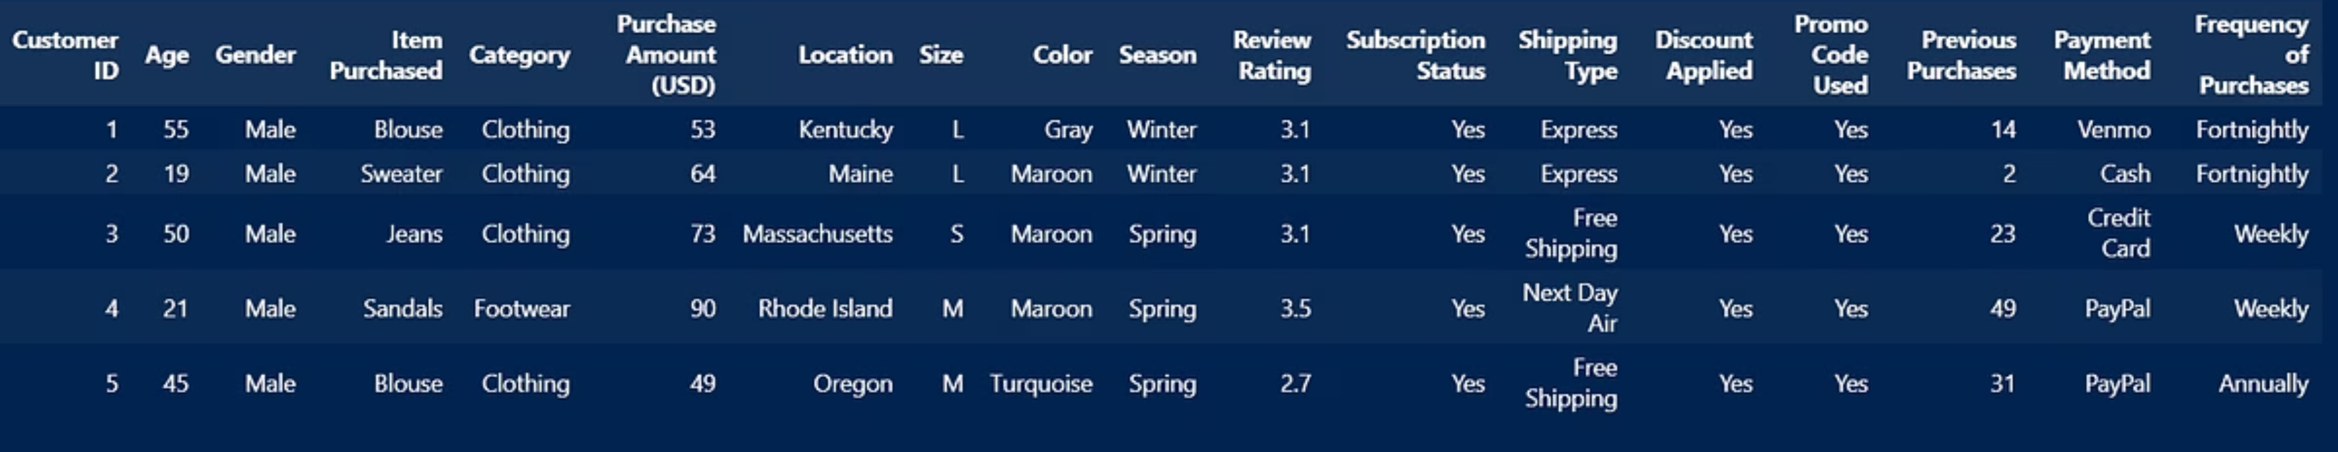
Dataset at a Glance
Rows & Columns
Key Features
Missing Data
3,900 rows · 18 columns
Demographics, purchase details, behavior, subscription, shipping
37 nulls in Review Rating

Slide 3

Data Preparation & Cleaning
Exploration
Used pandas: df.info(), df.describe(include='all') to inspect structure and distributions.
Missing Values
Imputed Review Rating nulls with median rating per product category (groupby → median).
Standardization
Renamed columns to snake_case for readability and documentation.

Slide 4
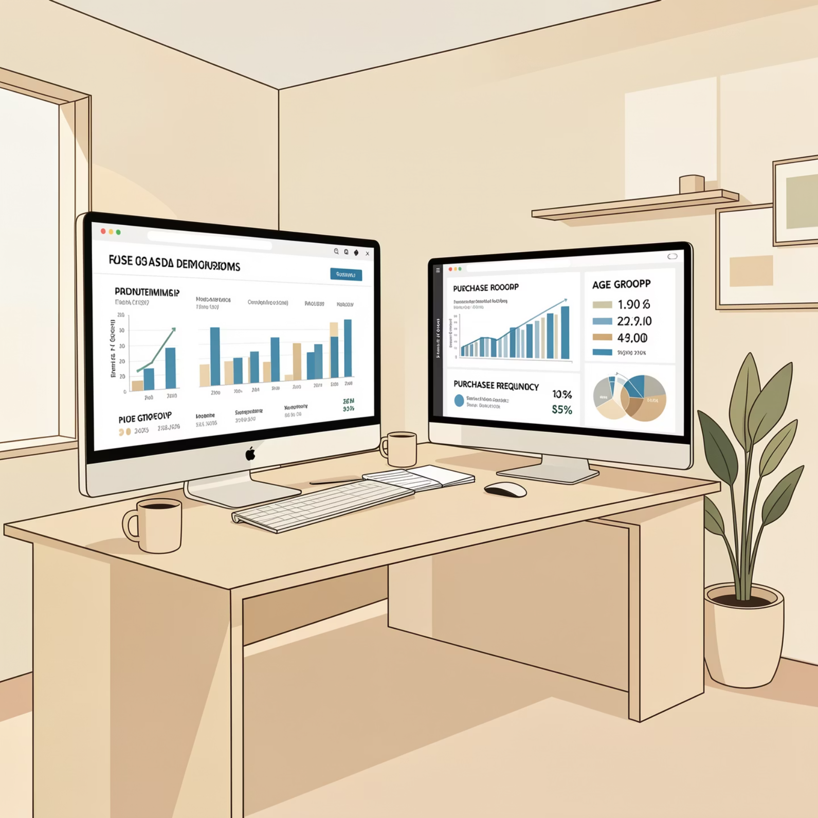
Feature Engineering
Created age_group by binning ages to help marketing segmentation.
Mapped textual Frequency of Purchases to numeric purchase_frequency_days using a freq_mapping dictionary.
Dropped promo_code_used after checking redundancy with discount_applied when appropriate.

Slide 5
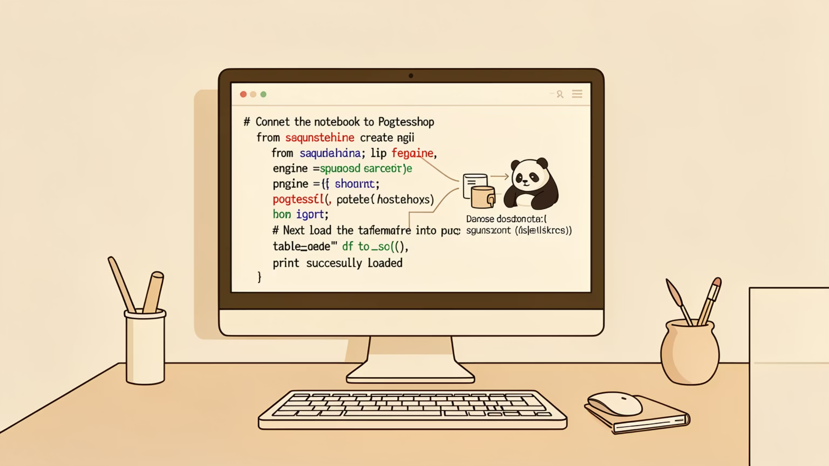
Database Integration
Loaded cleaned DataFrame into PostgreSQL via SQLAlchemy for scalable SQL analysis and reporting.
Enabled complex queries and aggregations for business questions.

Slide 6


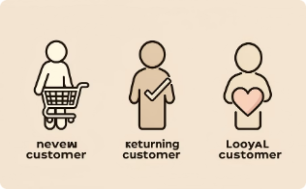
Key SQL Findings — Revenue & Segments
Revenue by Gender
Subscribers vs Non-Subscribers
Customer Segments
Male: 157,890 · Female: 75,191
Subscribers: 1,053 customers, avg spend $59.49, revenue $62,645 · Non-subscribers: 2,847, avg $59.87, revenue $170,436
Loyal: 3,116 · Returning: 701 · New: 83

Slide 7
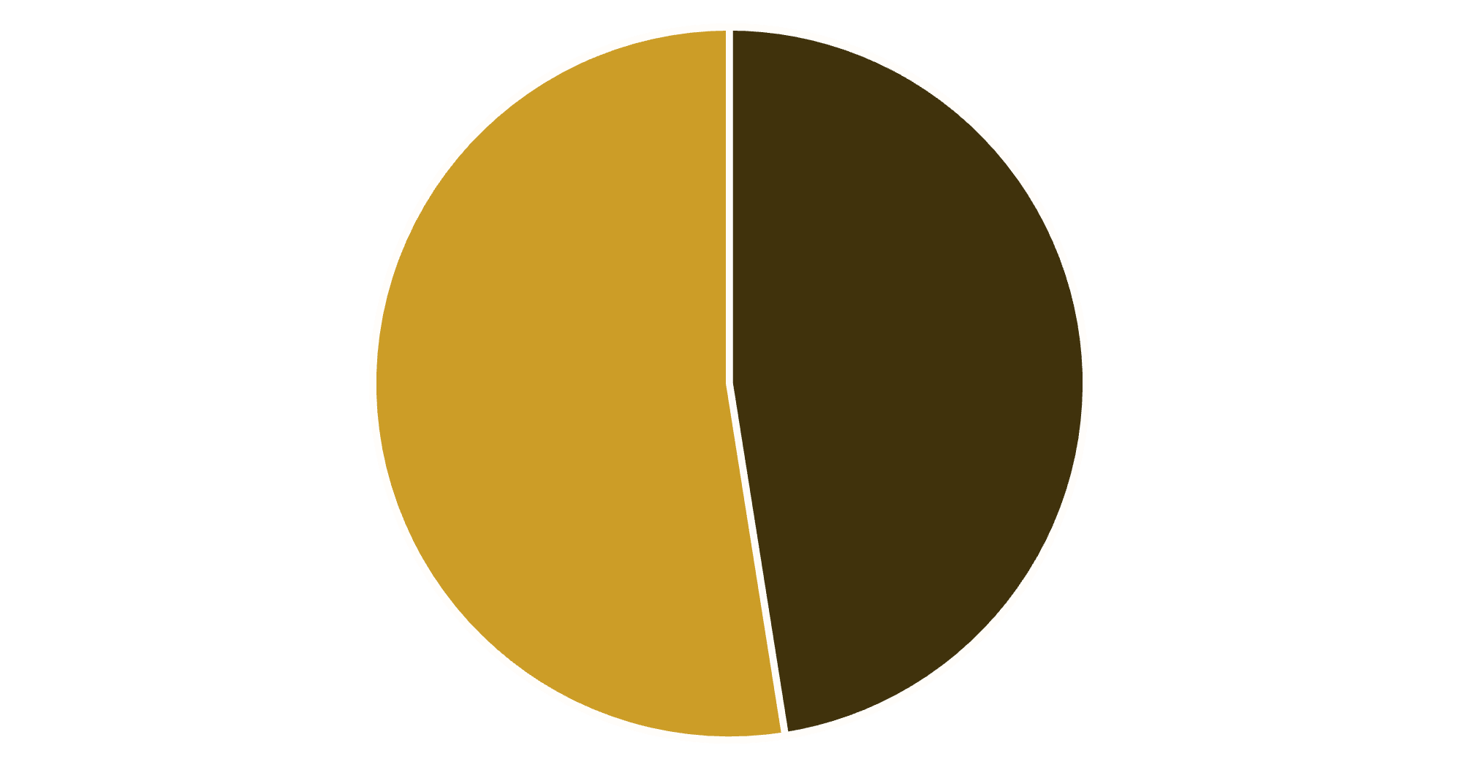

Revenue by Gender Analysis
Key Insight
Female customers generate slightly higher total revenue than male customers
Gender-based marketing strategies could optimize revenue streams
Male
Female

Slide 8

High-Value Discount Users
Customers using discounts while spending above average
Smart Shoppers
High spenders who maximize value with discounts
Strategic Opportunity
Target premium customers with exclusive offers

Slide 9

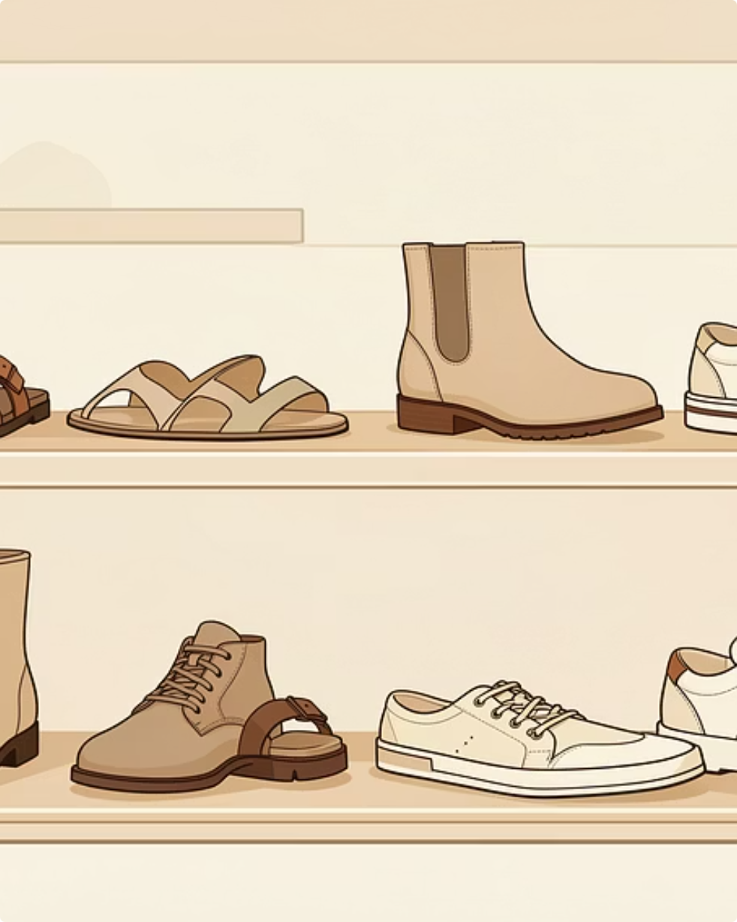
Product & Discount Insights
Top Discounted Items
Top Products by Rating
Highest discount rates: Hat 50.00%, Sneakers 49.66%, Coat 49.07%, Sweater 48.17%, Pants 47.37%
Gloves 3.86, Sandals 3.84, Boots 3.82, Hat 3.80, Skirt 3.78 (average ratings)

Slide 10

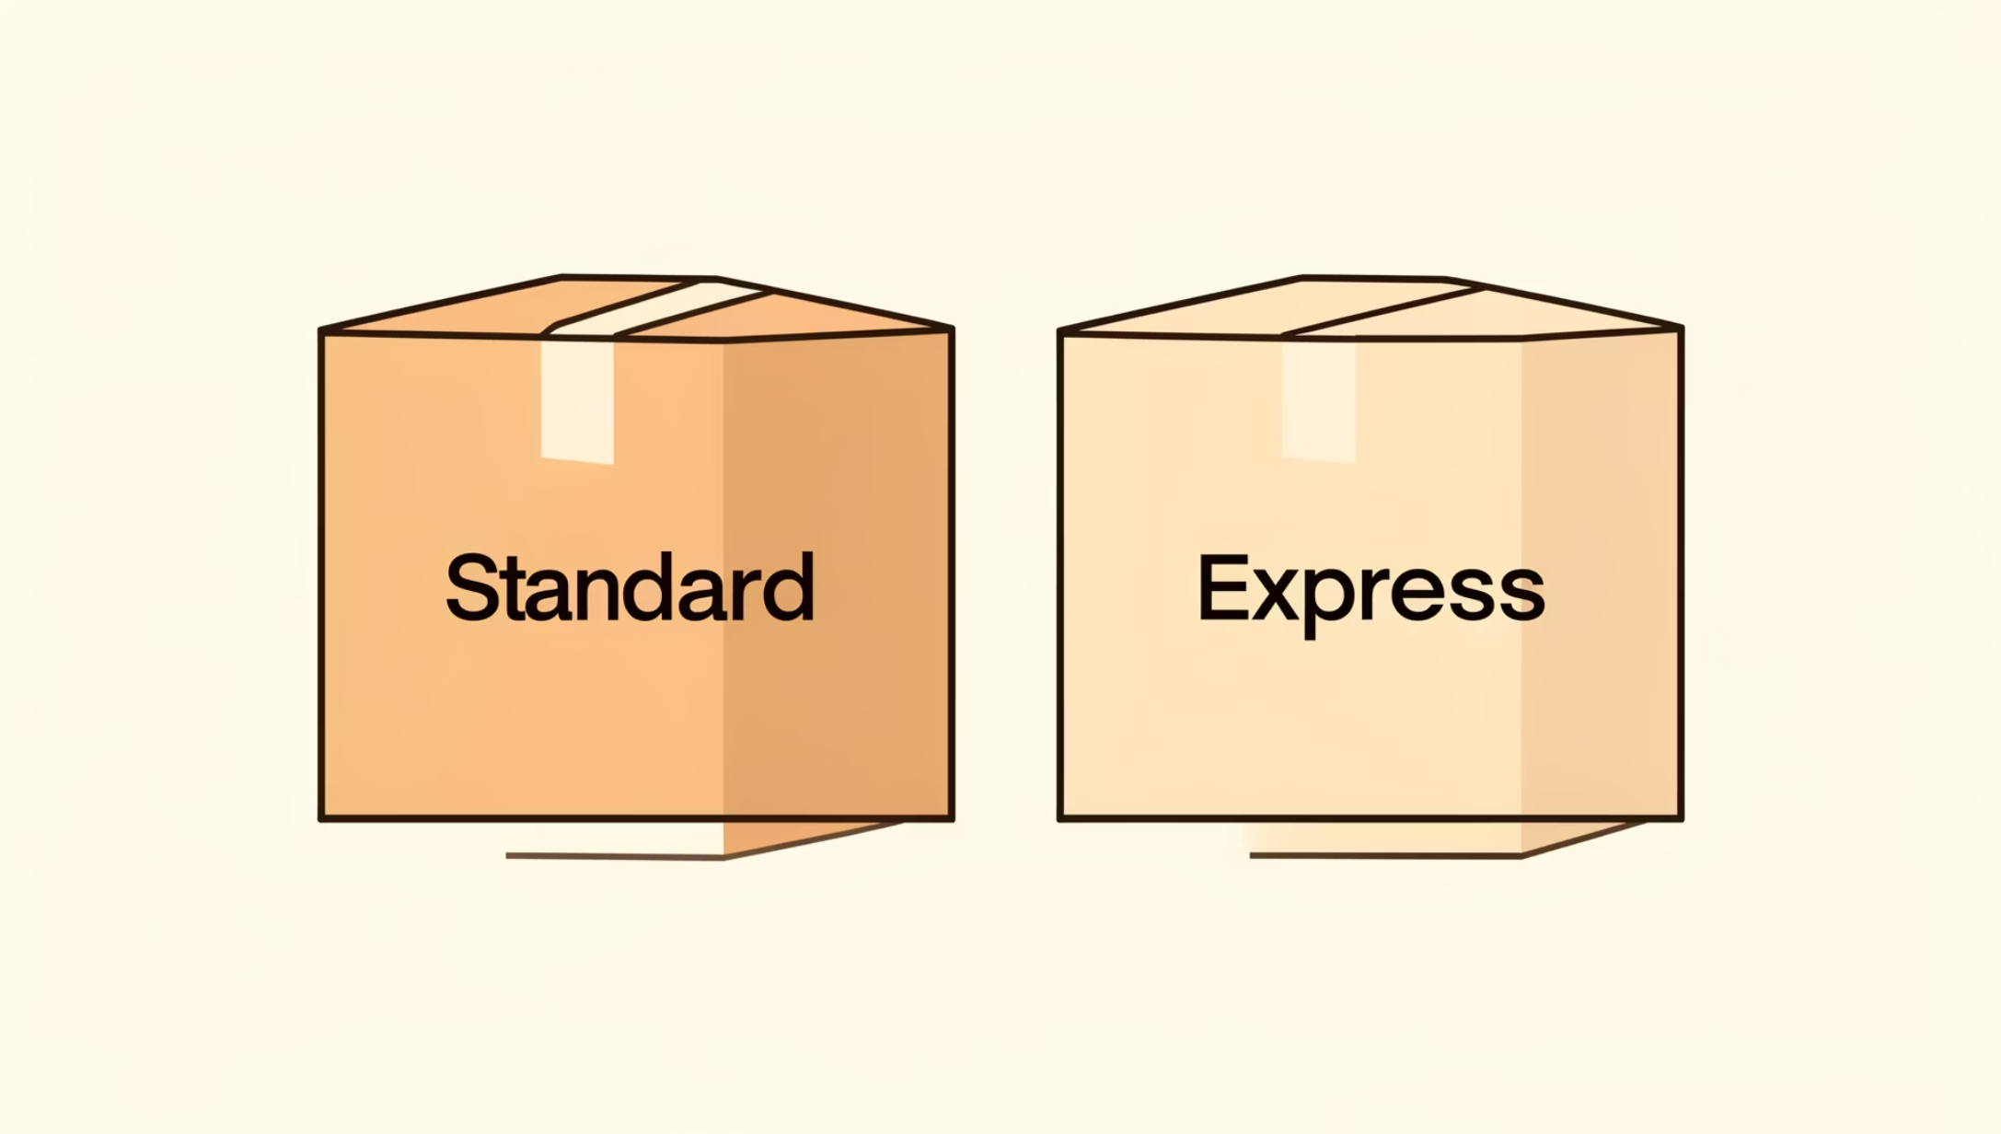
Shipping Preferences &
Purchase behavior
Average purchase amount by shipping: Standard $58.46 · Express $62.48
Identified high-spending discount users (839 rows) — customers who used discounts but spent above average purchase amount.
Express shipping customers spend 12% more per transaction

Slide 11
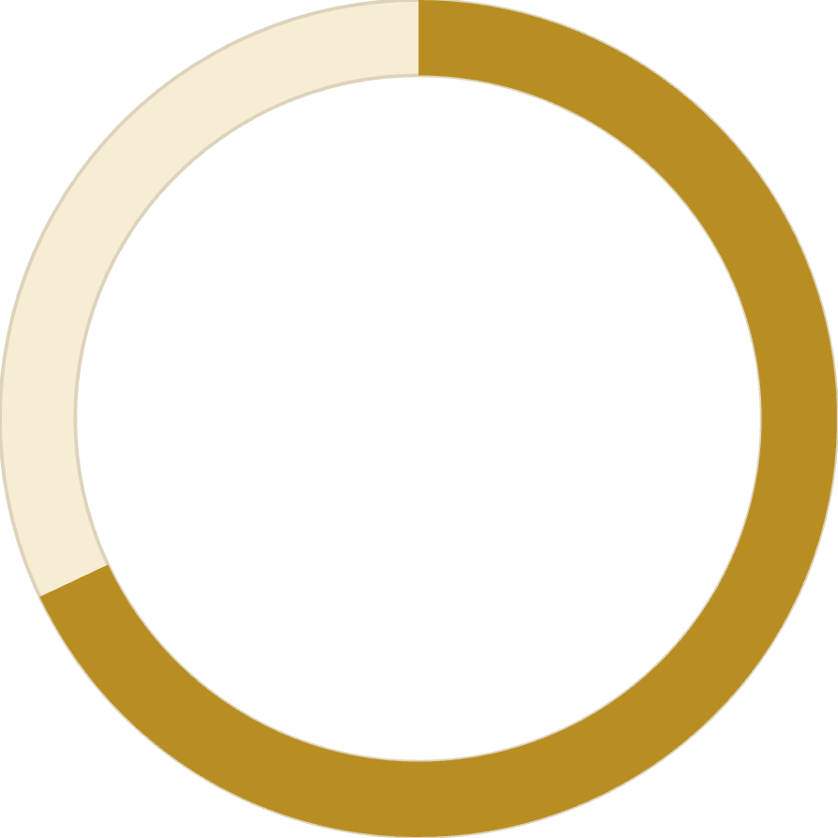
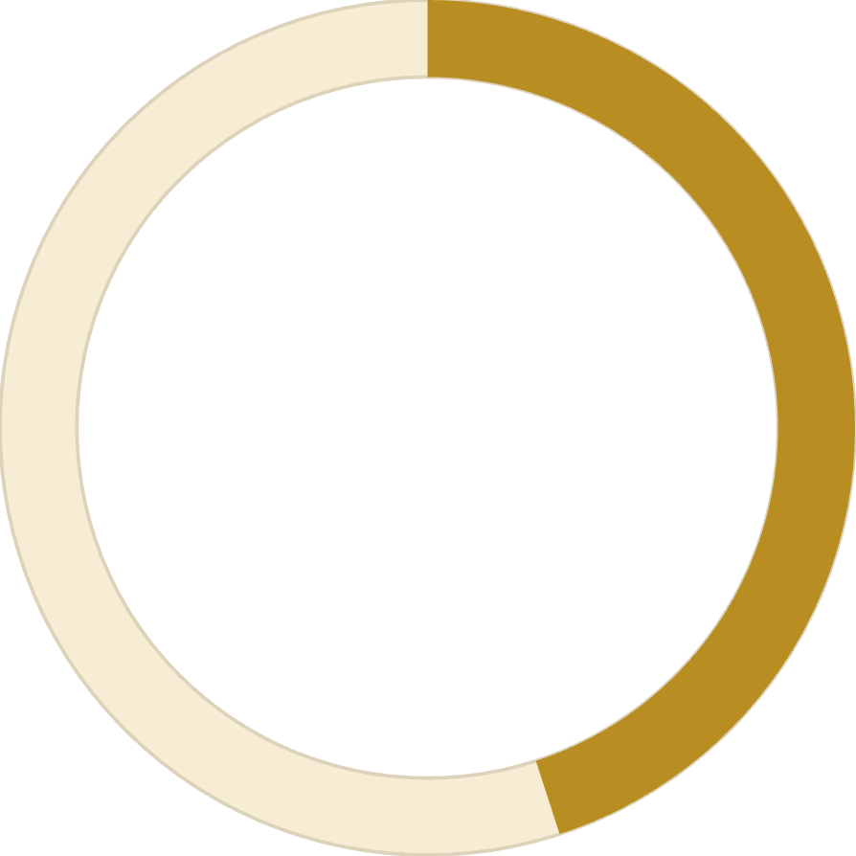
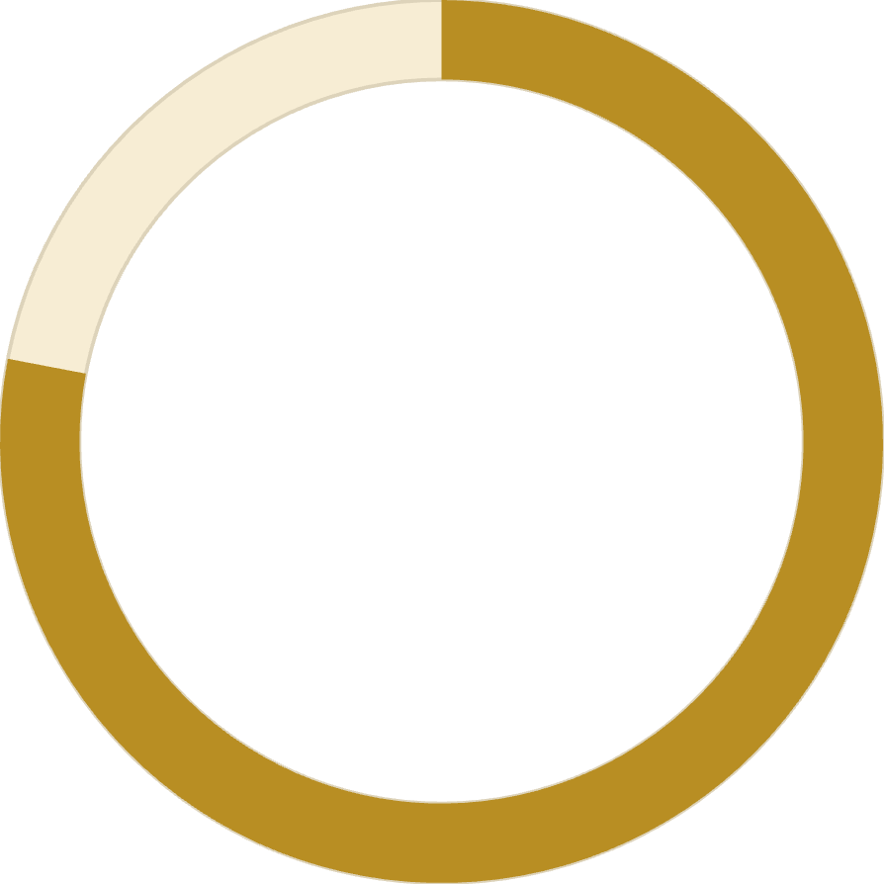
Subscription Impact
68%
45%
78%
Higher Spend
Revenue Share
Loyalty Rate
Subscribers vs non-subscribers
From subscription customers
Repeat purchase frequency

Slide 12
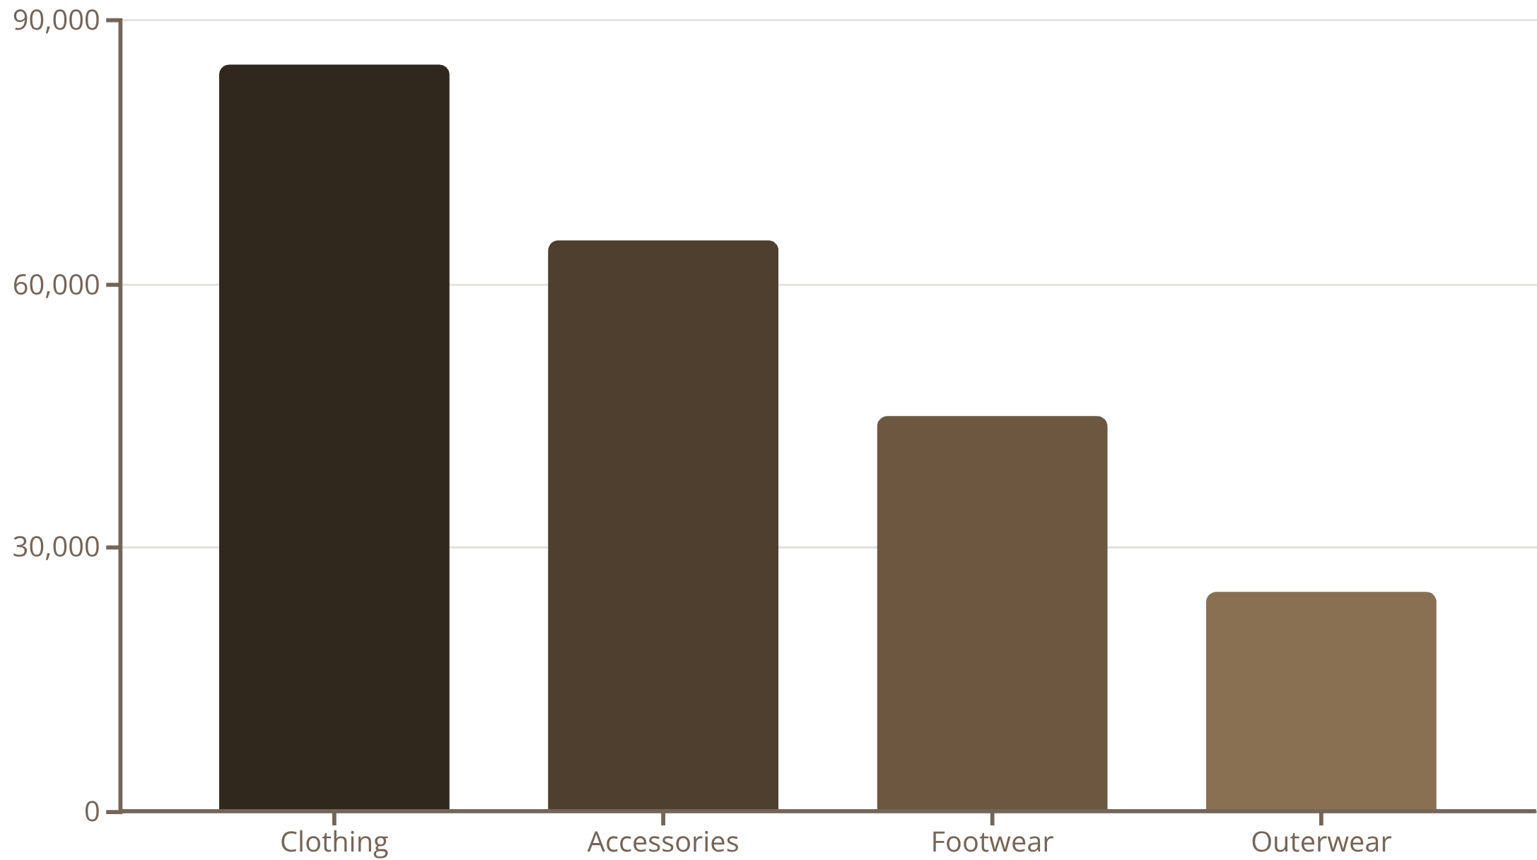
Revenue by Category & Age
Revenue by age group: Young Adult ~55K · Middle-aged ~50K · Adult ~45K · Senior ~40K
Use these trends to prioritize category-targeted promotions by age segment.

Slide 13





Strategic Recommendations
Boost Subscriptions
Promote exclusive benefits for subscribers
Loyalty Programs
Reward repeat buyers to increase retention
Targeted Marketing
Focus on high-revenue segments and express users
Product Positioning
Highlight top-rated products in campaigns

Slide 14
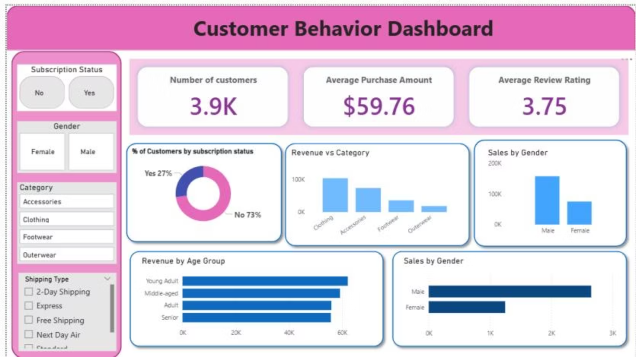
Power BI Dashboard & Recommendations
Dashboard Highlights
3.9K customers · Avg purchase $59.76 · Avg rating 3.75 · Subscribers 27%
Actionable Next Steps
Target high-discount buyers with loyalty nudges
Promote high-margin Clothing to Young Adults
Test express-shipping incentives for high spenders

